Slide 1
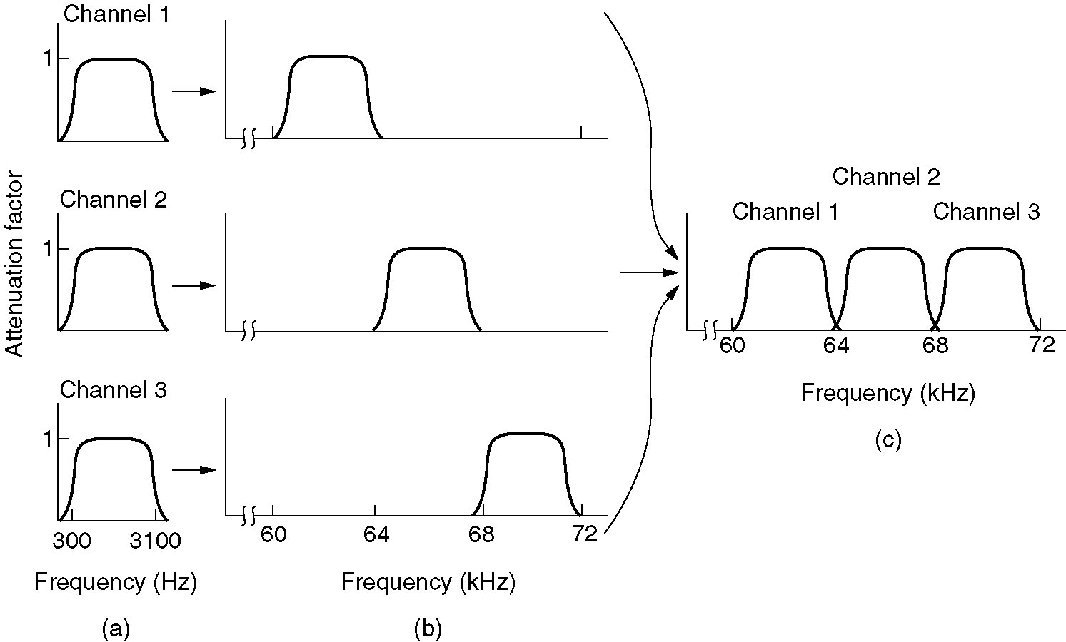
Frequency Division Multiplexing

Slide 2
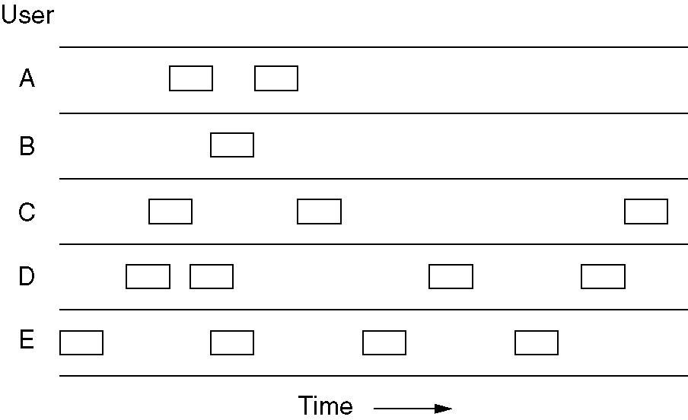
Pure ALOHA
Frames are transmitted at completely arbitrary times
Same length frames maximizes the throughput of ALOHA systems
Two frames concurrently trying to occupy the same channel will collide and will be garbled

Slide 3
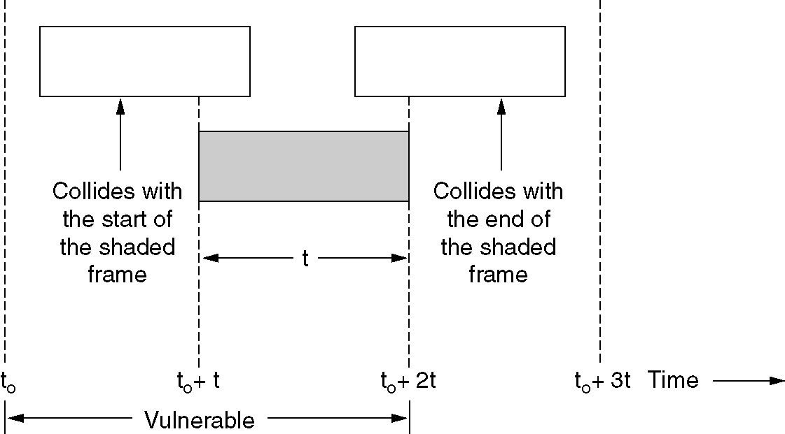
Pure ALOHA-Collisions

Slide 4
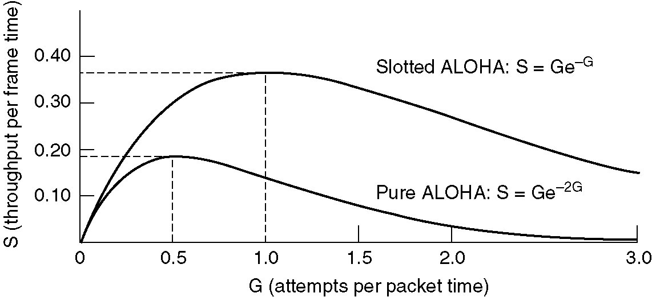
Pure ALOHA
Throughput versus offered traffic for ALOHA systems.

Slide 5
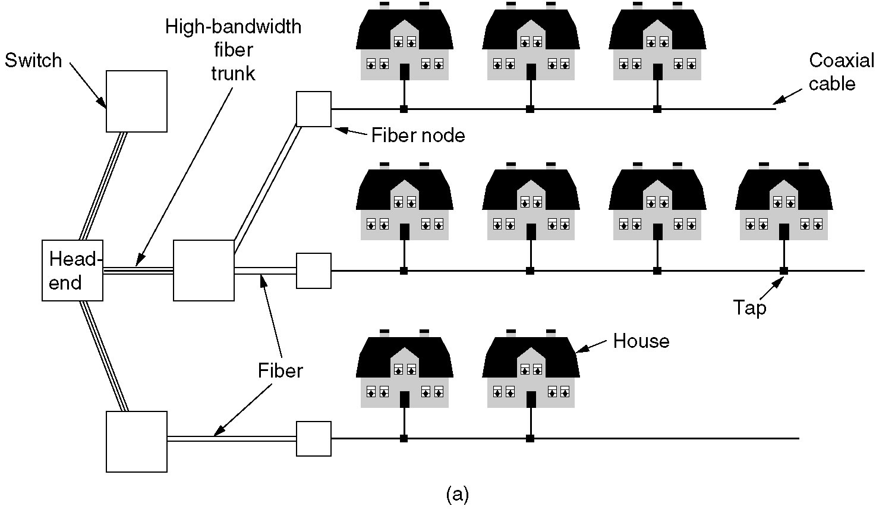
Internet over Cable
Cable television

Slide 6

Slotted ALOHA
Best case scenario for Slotted ALOHA
  37% (S = 1/e) throughput
  37% (e^{-G} with G = 1) slots empty
  26% collisions

Slide 7
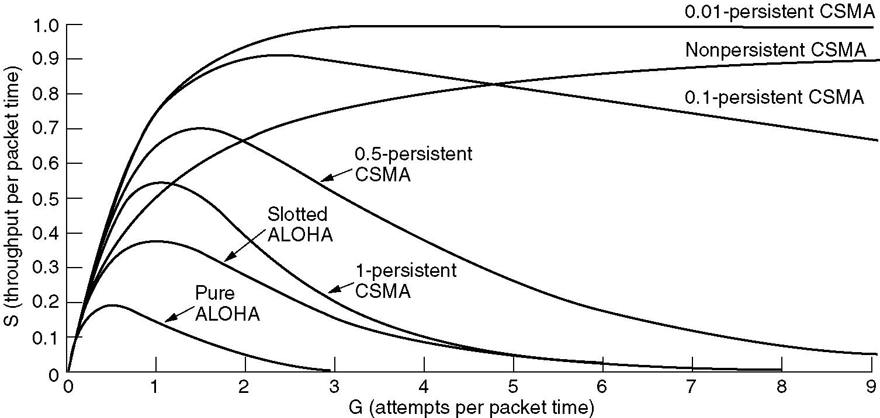
Persistent and Nonpersistent CSMA
Comparison of the channel utilization versus load for various random access protocols.

Slide 8
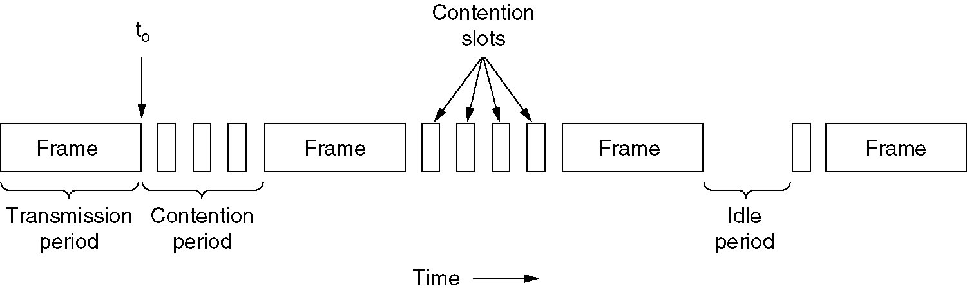
CSMA with Collision Detection (CSMA/CD)

